Slide 1
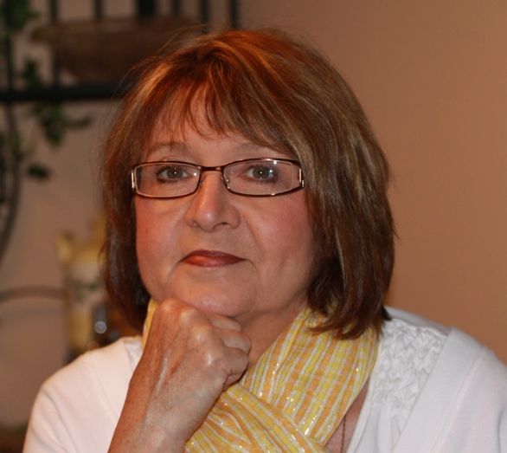
NEW GROWTH FAMILY CENTRE Inc.
Information About Attention Deficit Disorder
for Parents, Caregivers.
Presented by
Aletha McArthur, OCT
Special Education & Behaviour Specialist
Founder of New Growth Family Centre Inc.
Session 2

Slide 2
R
E A
V OF D
I H
E D
W

Slide 3
What did you find out?

Slide 4
What questions do you have ?

Slide 5
What do I do about it ?

Slide 6
Step 1
Thinking Change
** The Child can`t YET !
** The Child is not doing it to me.

Slide 7
Step 2
** Recognize my own triggers and
Face them.

Slide 8
Step 3
** Put a plan in place for personal
stress relief before I need it.

Slide 9
** Leave the room.
** Deep breaths to oxygenate the
brain.
** Water breaks to hydrate the brain.
** Exercise break to increase blood
flow the brain.
** Call someone else to ``sit tight” and
maintain the calm.

Slide 10
Allows Calming, Regulation, Oxytocin
release in the Adult brain.

Slide 11
Step 4
Modify My blueprint how I was raised.
Modify our blueprint how we were raised.
Remember: The “Experts” do not live in my home with my children. I do !

Slide 12
The hardest change in the blueprint is:
Relationship is # 1 so when all else “fails”
in the moment call the child over to give
each other a hug.
Expecting “bad” from an adult is conditioned
into a child.
Doling out “bad” to a child is conditioned into
a child.

Slide 13
The true meaning of discipline is teaching by showing.
Input = Positive Outcomes.
New Message: When I call you , it’s a good thing.

Slide 14
What changes the outcome to be POSITIVE ?
#1 The adult’s attitude and responses.
#2 The adult’s stress level.
#3 The relationship with the adult.

Slide 15
Relationship ➔ Willingness ➔ Input
The adult becomes the calm, the balance, the structure-----the Brain.
Dependence ----- carrier seat.
Interdependence----talking things through, training wheels, planning , what if.
Independence-----riding own bike.

Slide 16
Where Can I get help ?
** New Growth Family Centre Inc.
--- Parent Coaching
--- Learning Matters
(support Group at NGFC Inc.)
** Websites but be discerning.
** Other parents with older kids who are
successful.
** Medical Practitioners with experience ,
but do your own research first.

Slide 17
What about Medications ?
** An unknown area.
** Does not “FIX” behaviour
problems.
** Can open the way for the treatment
to begin.
** Never the first choice but may be an
additional last choice.
** When it works, it works.
Become an expert yourself

Slide 18
Where do I get Support ?
** Medical Route
** Mental Health Route

Slide 19
How Can I help my child at school ?
** Know your child.
** Share what you know with the teacher
every year.
** Ask questions about the classroom environment,
the expectations, the structure.
** Initiate communication and make yourself known
in a positive way to the teacher and support staff.
** Do not wait for the school to “discover”
your child.

Slide 20
What can I do in my home ?
#1 Explain ADHD to us in a clear, simple
terms and tell us what it looks like in us.
#2 Tell us what’s good about us.
#3 Show us how to use our energy to get
things done, have fun, and be the spice
life.

Slide 21
#4 Tell us honestly what we’re doing that
irritates people around us.
#5 Show us amazing things in the world so
that we can get excited about learning.
#6 Show us ways to organize our things so
that we can find what we need easily
to reduce frustration.

Slide 22
#7 Show us how to use a calendar, memory
helps and a watch to keep track of time
to get excited about tomorrow and look
back at all we accomplished yesterday.
#8 Show us how to relax when things get
hectic and we start feeling disregulated.

Slide 23
#9 Teach us about disregulation,
frustration
and anger. Show us how to calm before
an embarrassing blow-up erupts.
#10 Teach us ways to focus our attention
on important things at hand.

